Slide 1
Math
Why do we learn math
刘柏田

Slide 2
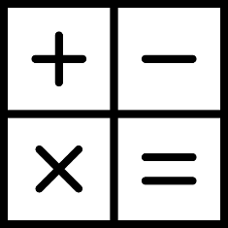
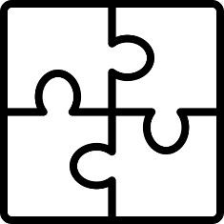

01
02
03
Calculation
Application
Inspiration

Slide 3
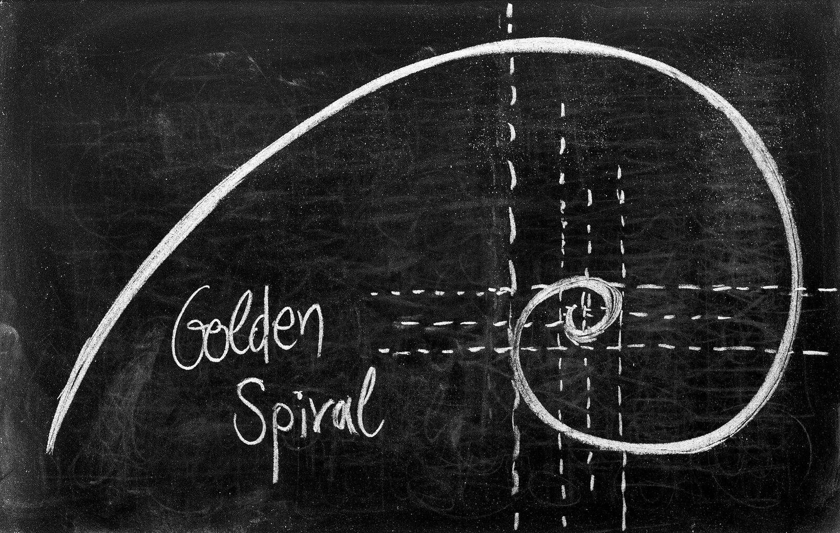
Will we learn math just for
fun or beautiful?
Will it be?

Slide 4
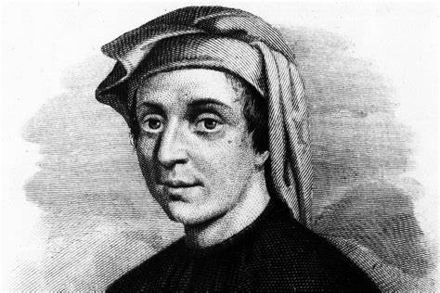
The Fibonacci Numbers
1
1
2
3
5
8
13
21
34
55
….

Slide 5
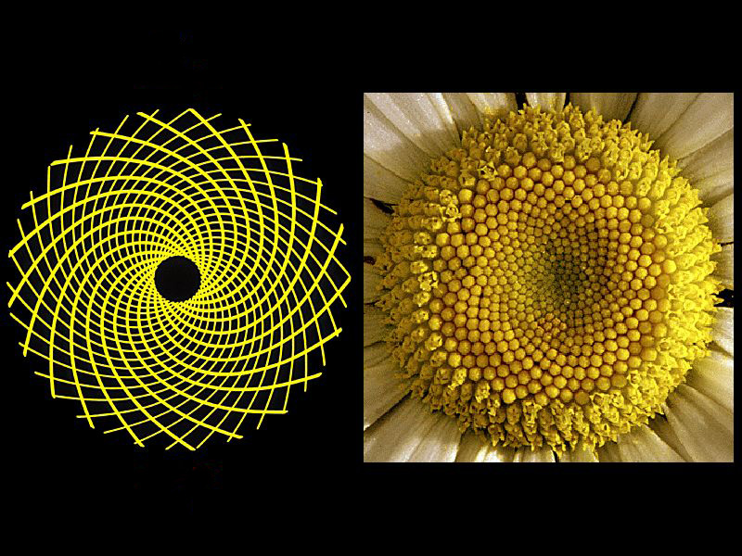
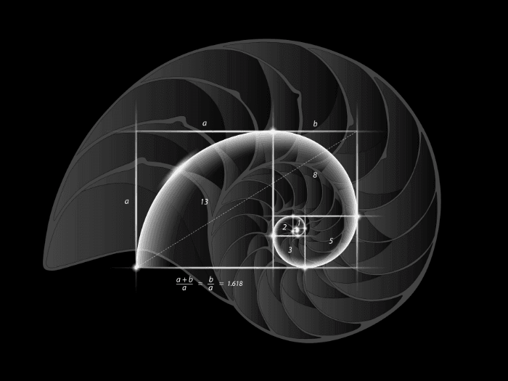
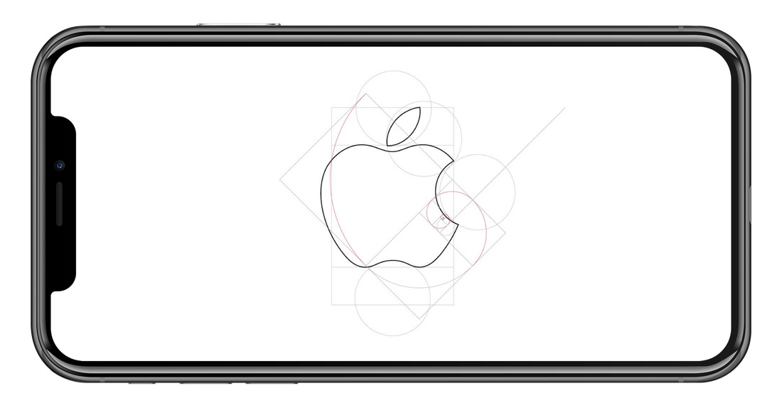
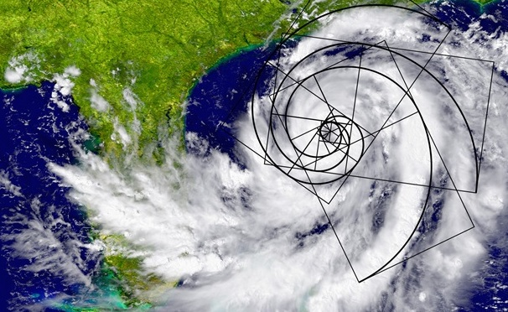

Slide 6

The Fibonacci Numbers
1
1
4
9
25
64
169
441
1156
3025
….
1 + 1 + 4 = 6
= 2 × 3
1 + 1 + 4 + 9 = 15
= 3 × 5
1 + 1 + 4 + 9 + 25 = 40
= 5 × 8
1 + 1 + 4 + 9 + 25 + 64 = 104
= 8 × 13
1
1
2
3
5
8
13
21
34
55
….
$1^{2}$+ $1^{2}$+ $2^{2}$+ $3^{2}$+ $5^{2}$+ $8^{2}$ = 8 × 13
Why ???

Slide 7






1
1
3
2
8
8
5
5+8
Area = Sum of the area of the Squares
Area =
$$1^{2}+$$
$$1^{2}+$$
$$2^{2}+$$
$$3^{2}+$$
$$5^{2}+$$
$$8^{2}$$
= ( 5 + 8 ) × 8

Slide 8
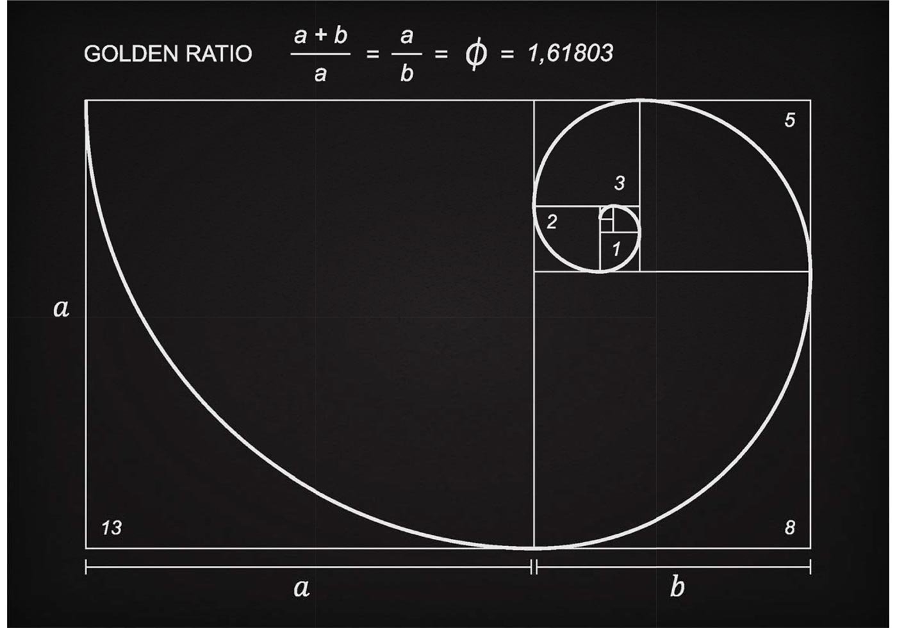
8 × 13
13 ÷ 8 =
1.625
13 × 21
21 ÷ 13 =
1.615…
21 × 34
34 ÷ 21 =
1.619…
34 × 55
55 ÷ 34 =
1.6176…
55 × 89
89 ÷ 55 =
1.61818…

Slide 9
Mathematic is not just about
Solving for X
WH
It is also figuring out Y
End

